Slide 1

Amazon Web Services
By Shankar Banavasi
13/07/17
July 2017, Shankar Banavasi
1
Notes:
1
13/07/17
Shankar Banavasi
Shankar Banavasi

Slide 2
What is Cloud Computing?
Cloud Computing is the on-demand delivery of
computer power, database storage, applications
and other IT resources through a cloud services
platform via the Internet with pay-as-you-go
pricing
13/07/17
July 2017, Shankar Banavasi
2

Slide 3

What is Amazon EC2?
Amazon Elastic Compute Cloud (Amazon EC2) provides scalable computing capacity in the Amazon Web Services (AWS) cloud.
Using Amazon EC2 eliminates your need to invest in hardware up front, so you can develop and deploy applications faster. You can use Amazon EC2 to launch as many or as few virtual servers as you need, configure security and networking, and manage storage.
Amazon EC2 enables you to scale up or down to handle changes in requirements or spikes in popularity, reducing your need to forecast traffic.
13/07/17
July 2017, Shankar Banavasi
3

Slide 4
Features of Amazon EC2
Amazon EC2 provides the following features:
Virtual computing environments, known as instances
Preconfigured templates for your instances, known as Amazon Machine Images (AMIs), that package the bits you need for your server (including the operating system and additional software)
Various configurations of CPU, memory, storage, and networking capacity for your instances, known as instance types
Secure login information for your instances using key pairs
(AWS stores the public key, and you store the private key in a secure place)
13/07/17
July 2017, Shankar Banavasi
4

Slide 5
Features of EC2(Continued)
Storage volumes for temporary data that's
deleted when you stop or terminate your
instance, known as instance store volumes
Persistent storage volumes for your data using
Amazon Elastic Block Store (Amazon EBS),
known as Amazon EBS volumes
Multiple physical locations for your resources,
such as instances and Amazon EBS volumes,
known as regions and Availability Zones
13/07/17
July 2017, Shankar Banavasi
5
Notes:
5
13/07/17
Shankar Banavasi
Shankar Banavasi

Slide 6
Features of EC2 (Continued)
A firewall that enables you to specify the protocols, ports, and
source IP ranges that can reach your instances using security
groups
Static IPv4 addresses for dynamic cloud computing, known
as Elastic IP addresses
Metadata, known as tags ,that you can create and assign to
your Amazon EC2 resources
Virtual networks you can create that are logically isolated
from the rest of the AWS cloud, and that you can optionally
connect to your own network, known as virtual private
clouds(VPCs)

Slide 7
Amazon EC-2
Login to https://aws.amazon.com/solutions
Register and create an AWS console management account by using a user-name and password
Navigate to https://aws.amazon.com/ec2/?nc2=h_m1
Navigate to “Products” tab on the above mentioned url
Click on “Amazon EC2” link mentioned in the “Products” tab
Click on “Get started with Amazon EC2” link
You can then view the EC2 dashboard on the top left pane on which you have various options
Options include Events, Tags, EC2 Usage Reports and Limits
You can choose to create and launch an instance among a host of other applications as per requirements as can be observed from the following screenshots
13/07/17
July 2017, Shankar Banavasi
7

Slide 8
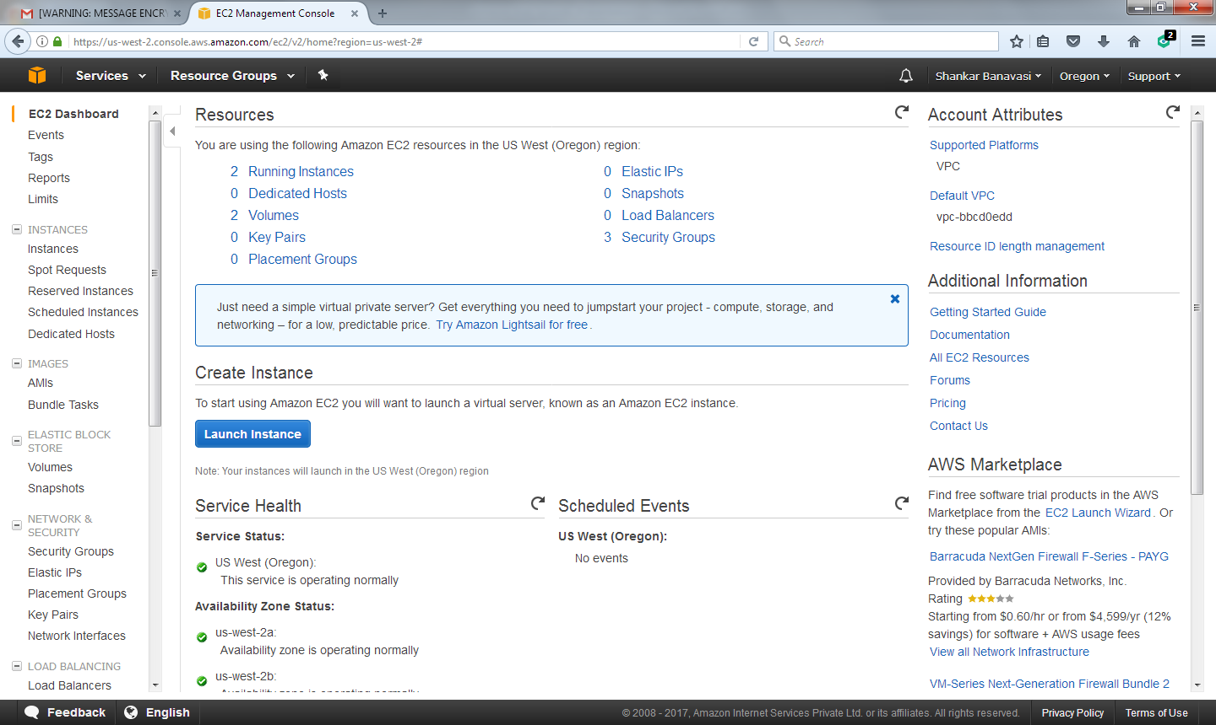
Sample EC2 Instance(continued)
13/07/17
July 2017, Shankar Banavasi
8

Slide 9
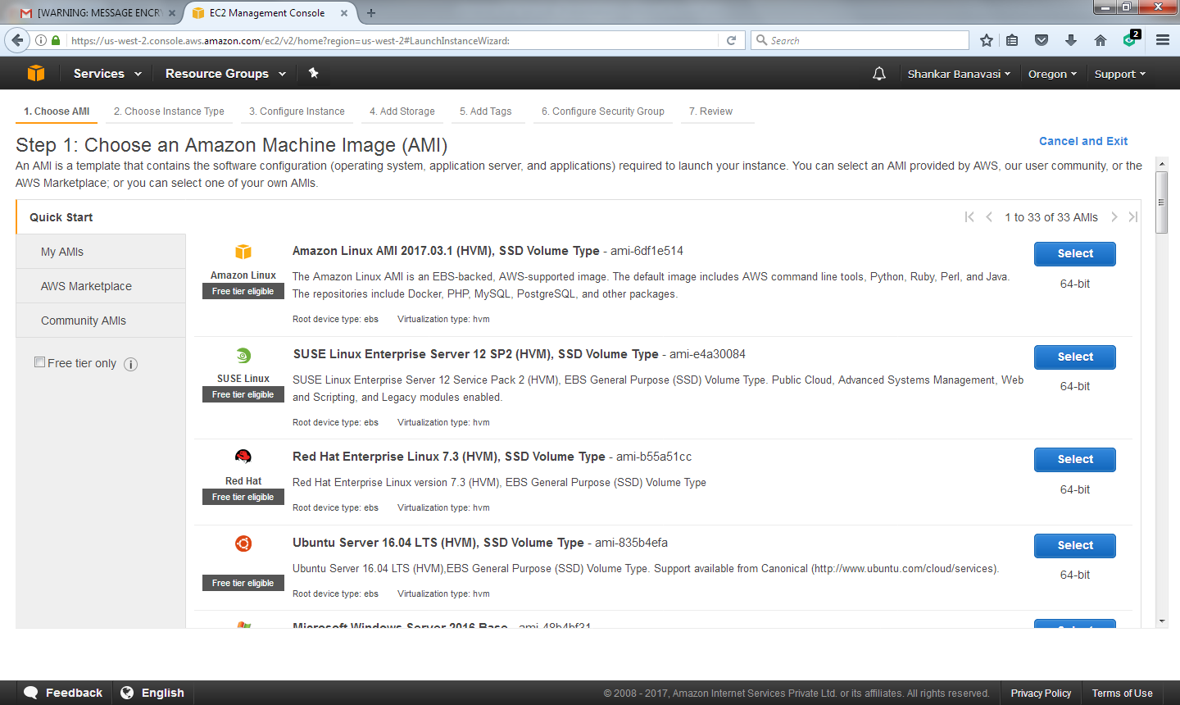
Sample EC2 Instance(Continued)
13/07/17
July 2017, Shankar Banavasi
9

Slide 10
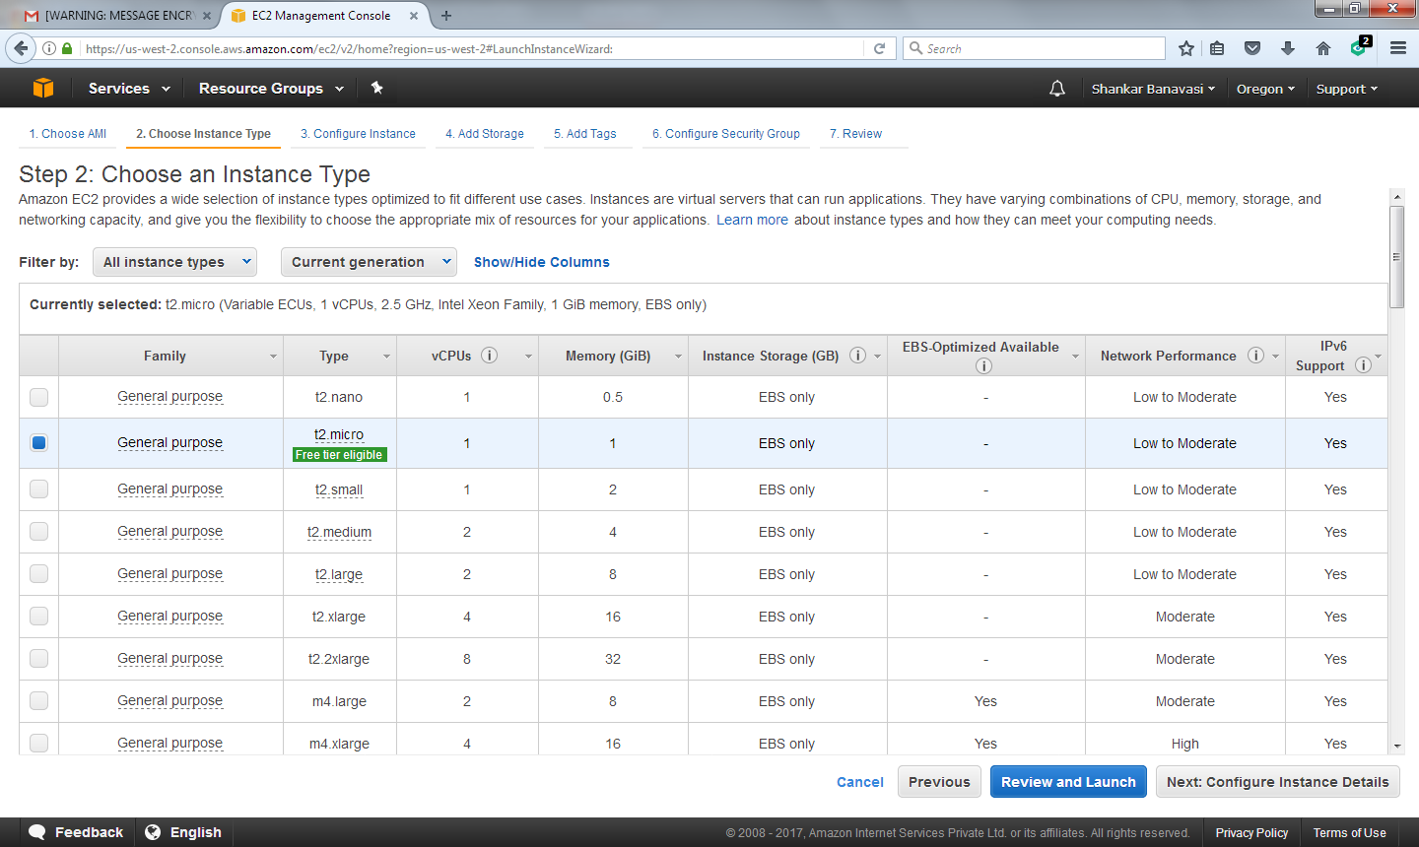
Sample EC2 Instance(Continued)
13/07/17
July 2017, Shankar Banavasi
10

Slide 11
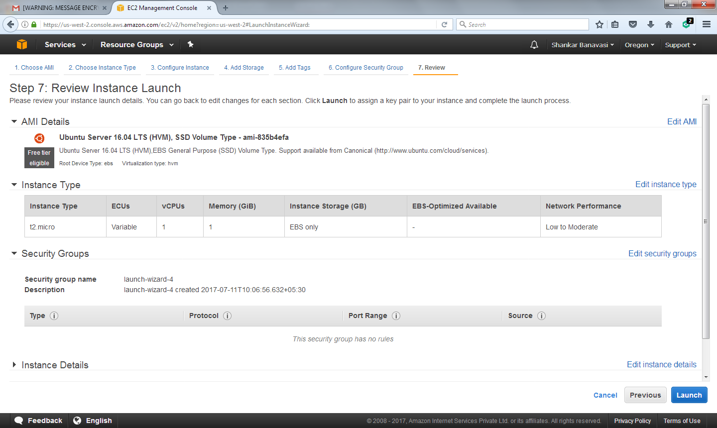
Sample EC2 Instance(Continued)
13/07/17
July 2017, Shankar Banavasi
11

Slide 12
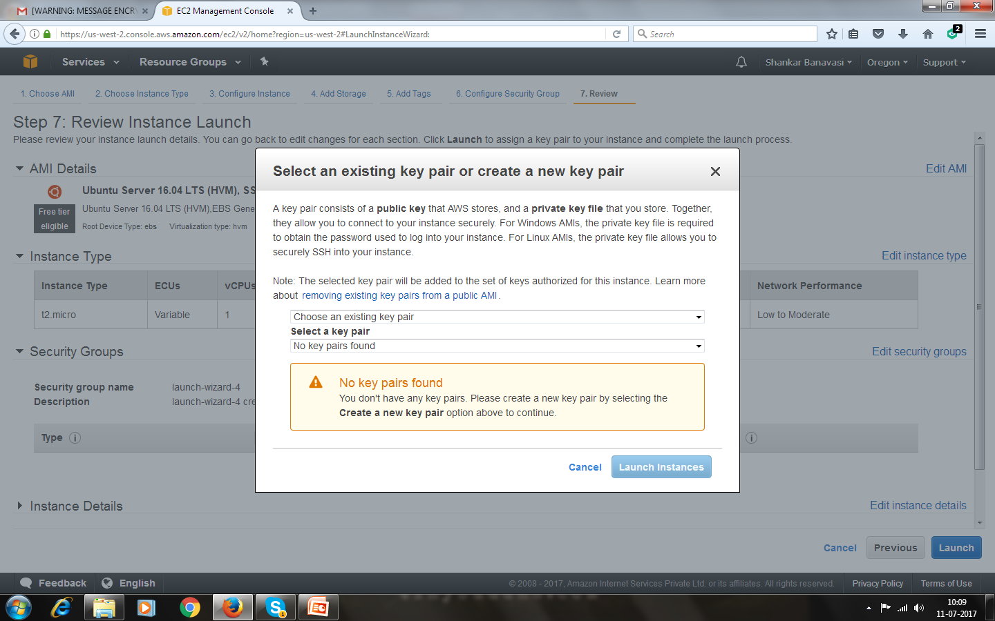
Sample EC2 Instance(Continued)
13/07/17
July 2017, Shankar Banavasi
12

Slide 13
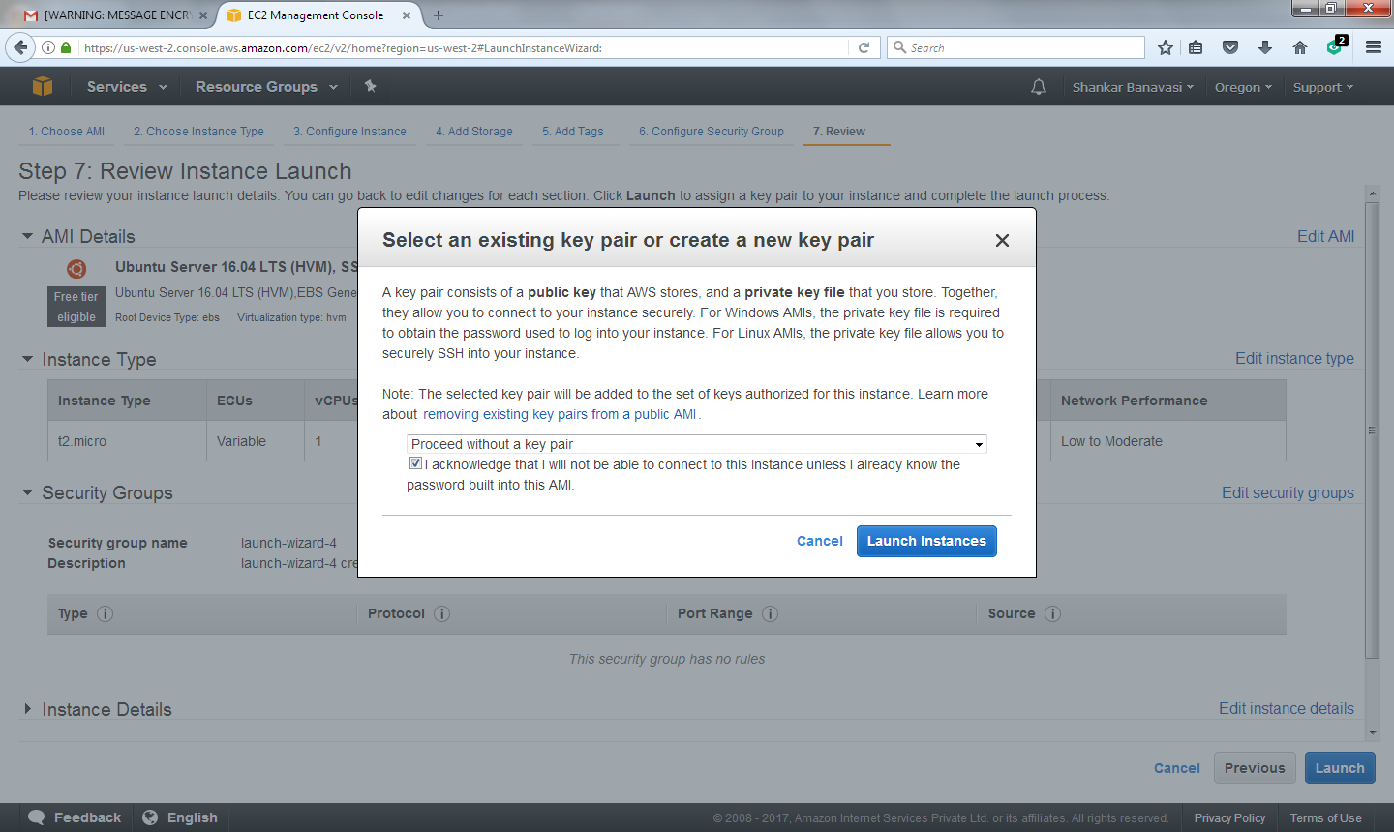
Sample EC2 Instance(Continued)
13/07/17
July 2017, Shankar Banavasi
13

Slide 14
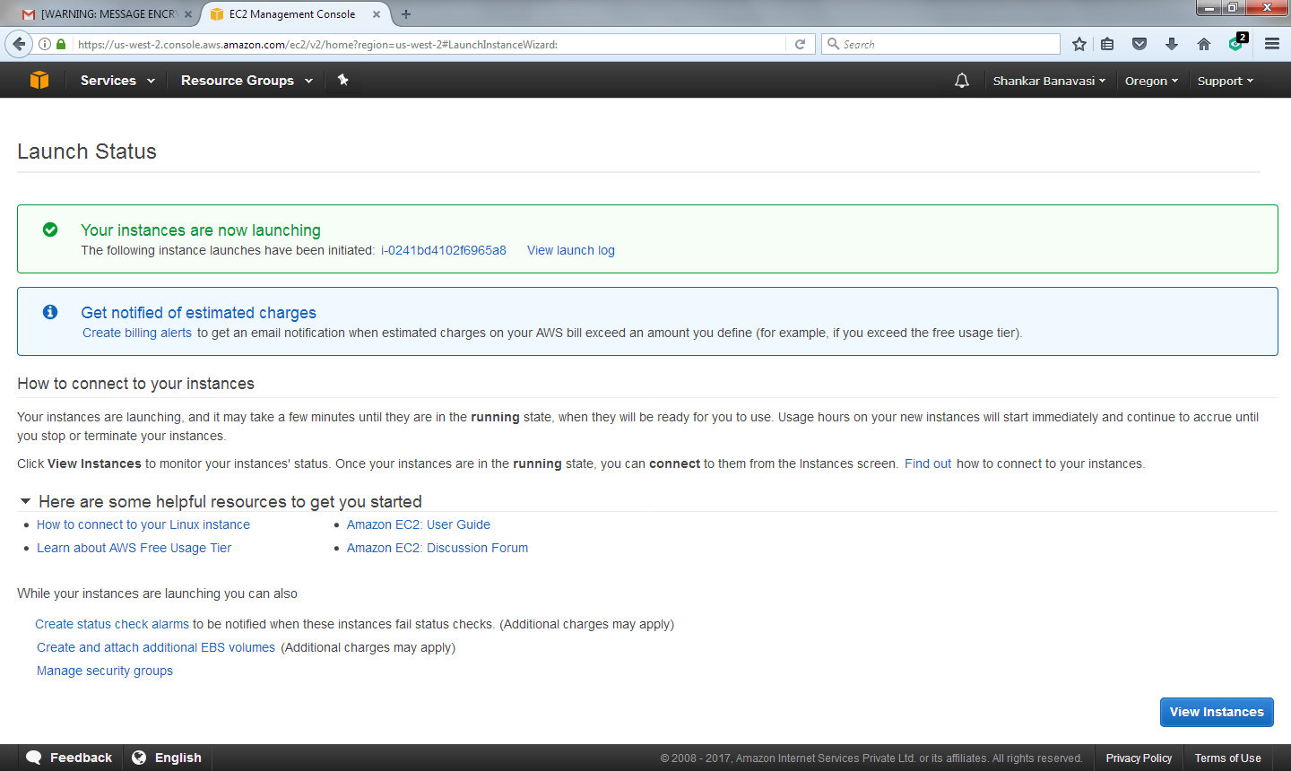
Sample EC2 Instance
13/07/17
July 2017, Shankar Banavasi
14

Slide 15
Sample EC2 Instance(Continued)
13/07/17
July 2017, Shankar Banavasi
15

Slide 16
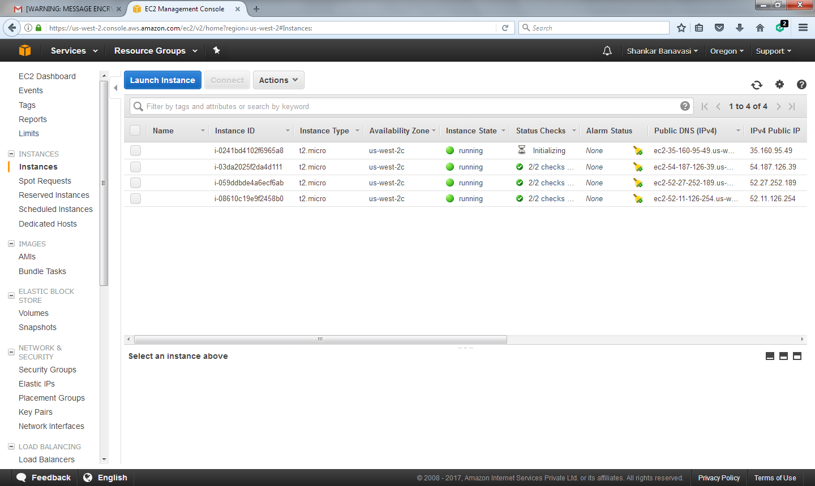
Sample EC2 Instance(Continued)
13/07/17
July 2017, Shankar Banavasi
16

Slide 17
Benefits of Amazon EC2
Elastic Web-Scale Computing
Amazon EC2 enables you to increase or decrease capacity within minutes, not hours or days. You can commission one, hundreds, or even thousands of server instances simultaneously. Because this is all controlled with web service APIs, your application can automatically scale itself up and down depending on its needs.
Completely Controlled
13/07/17
July 2017, Shankar Banavasi
17

Slide 18
Benefits of Amazon EC2
You have complete control of your Amazon EC2 instances. You have root access to each one, and you can interact with them as you would any machine. You can stop your Amazon EC2 instance while retaining the data on your boot partition, and then subsequently restart the same instance using web service APIs. Instances can be rebooted remotely using web service APIs

Slide 19
Benefits of Amazon EC2(continued)
Flexible Cloud Hosting Services
You can choose among multiple instance types, operating systems, and software packages. Amazon EC2 allows you to select the memory configuration, CPU, instance storage, and boot partition size that are optimal for your choice of operating system and application. For example, your choice of operating systems includes numerous Linux distributions and Microsoft Windows Server.
Integrated
Amazon EC2 is integrated with most AWS services, such as Amazon Simple Storage Service (Amazon S3), Amazon Relational Database Service (Amazon RDS), and Amazon Virtual Private Cloud (Amazon VPC) to provide a complete, secure solution for computing, query processing, and cloud storage across a wide range of applications
Reliable
Amazon EC2 offers a highly reliable environment where replacement instances can be rapidly and predictably commissioned. The service runs within Amazon’s proven network infrastructure and data centres. The Amazon EC2 Service Level Agreement (SLA) commitment is 99.95% availability for each Region
13/07/17
July 2017, Shankar Banavasi
19

Slide 20
Benefits of EC-2(continued)
Inexpensive
Amazon EC2 passes on to you the financial benefits of Amazon’s scale. You pay a very low rate for the compute capacity you actually consume.
On-Demand Instances—With On-Demand instances, you pay for compute capacity by the hour with no long-term commitments. You can increase or decrease your compute capacity depending on the demands of your application and only pay the specified hourly rate for the instances you use. The use of On-Demand instances frees you from the costs and complexities of planning, purchasing, and maintaining hardware and transforms what are commonly large fixed costs into much smaller variable costs. On-Demand instances also remove the need to buy “safety net” capacity to handle periodic traffic spikes.
13/07/17
July 2017, Shankar Banavasi
20

Slide 21
Benefits of EC2(continued)
Reserved Instances—Reserved Instances provide you with a significant discount (up to 75%) compared to On-Demand instance pricing. You have the flexibility to change families, operating system types, and tenancies while benefitting from Reserved Instance pricing when you use Convertible Reserved Instances.
Spot Instances—Spot Instances allow you to bid on spare Amazon EC2 computing capacity. Since Spot instances are often available at a discount compared to On- Demand pricing, you can significantly reduce the cost of running your applications, grow your application’s compute capacity and throughput for the same budget, and enable new types of cloud computing applications

Slide 22
Benefits of Amazon EC-2(Continued)
Secure
Amazon EC2 works in conjunction with Amazon VPC to provide security and robust networking functionality for your compute resources.
Your compute instances are located in a VPC with an IP address range that you specify. You decide which instances are exposed to the Internet and which remain private.
13/07/17
July 2017, Shankar Banavasi
22

Slide 23
Benefits of EC2(continued)
Security groups and network access control lists (ACLs) allow you to control inbound and outbound network access to and from your instances.
You can connect your existing IT infrastructure to resources in your VPC using industry-standard encrypted IPSec virtual private network (VPN) connections.
You can provision your Amazon EC2 resources as Dedicated Instances. Dedicated Instances are Amazon EC2 instances that run on hardware dedicated to a single customer for additional isolation.

Slide 24
Benefits of EC2(continued)
You can provision your Amazon EC2 resources on Dedicated Hosts, which are physical servers with EC2 instance capacity fully dedicated to your use. Dedicated Hosts can help you address compliance requirements and reduce costs by allowing you to use your existing server-bound software licenses

Slide 25
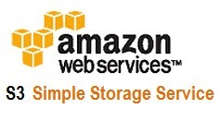
Storage – Amazon S3
Amazon Simple Storage Service (Amazon S3) is object storage with a simple web service interface to store and retrieve any amount of data from anywhere on the web. It is designed to deliver 99.999999999% durability, and scales past trillions of objects worldwide.
13/07/17
July 2017, Shankar Banavasi
25

Slide 26
Storage – Amazon S3
You can use Amazon S3 as primary storage for cloud-native applications; as a bulk repository, or "data lake," for analytics; as a target for backup and recovery and disaster recovery; and with server less computing.
It's simple to move large volumes of data into or out of Amazon S3 with Amazon's cloud data migration options. Once data is stored in Amazon S3, it can be automatically tiered into lower cost, longer-term cloud storage classes like Amazon S3 Standard - Infrequent Access and Amazon Glacier for archiving

Slide 27
Storage – Amazon S3
After having created an AWS account, type and login to the url https://aws.amazon.com/s3/?nc2=h_m1
Click on “Get started with Amazon S3”
You will then be led to the url https://console.aws.amazon.com/s3/home?region=us-west-2
Please observe the following screenshots
13/07/17
July 2017, Shankar Banavasi
27

Slide 28
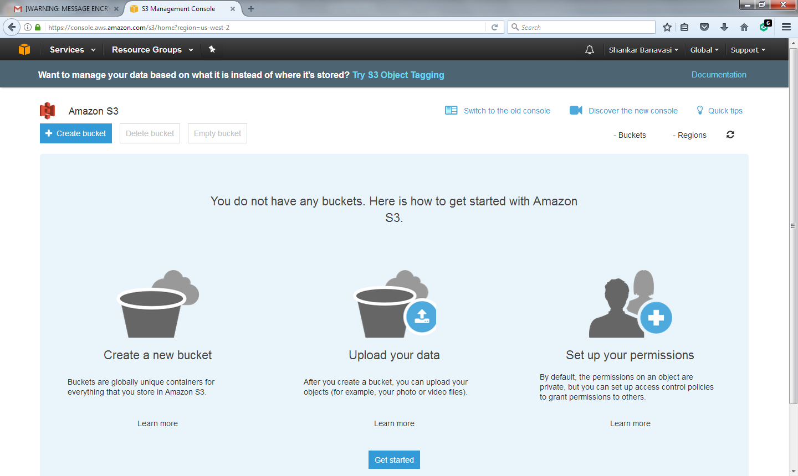
Storage – Amazon S3
13/07/17
July 2017, Shankar Banavasi
28

Slide 29
Storage – Amazon S3(Sample)
As you can observe on the previous slide, you have options namely, “Create a bucket”, “Upload Data” and “Set up your permissions”
You can select a DNS compliant bucket name, select a region and either choose to copy or not copy from an existing bucket
Click on next tab option to “Set Properties”, “Set Permissions” and “Review” as can be noted from the following screenshots
13/07/17
July 2017, Shankar Banavasi
29

Slide 30
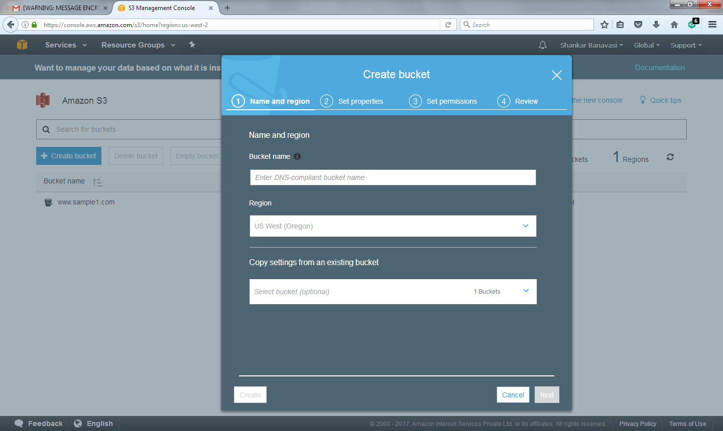
Storage – Amazon S3(Example, continued)
13/07/17
July 2017, Shankar Banavasi
30

Slide 31
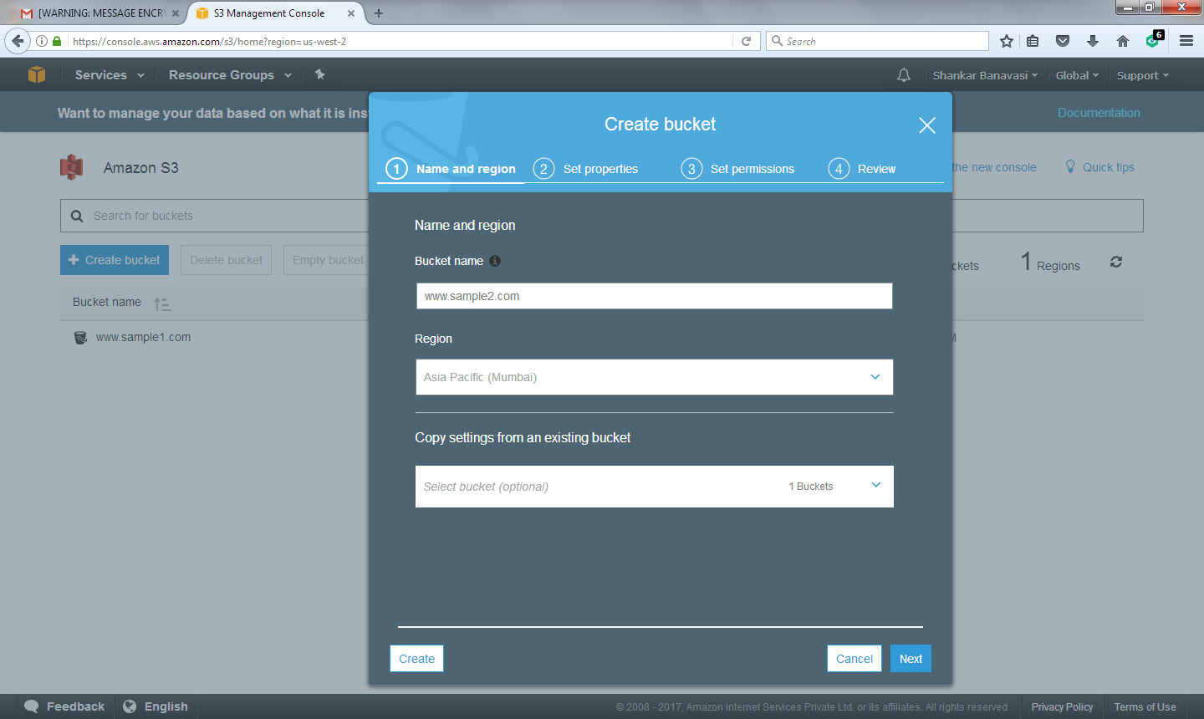
Storage – Amazon S3(Example,continued)
13/07/17
July 2017, Shankar Banavasi
31

Slide 32
Storage – Amazon S3 (Create Bucket)
13/07/17
July 2017, Shankar Banavasi
32

Slide 33
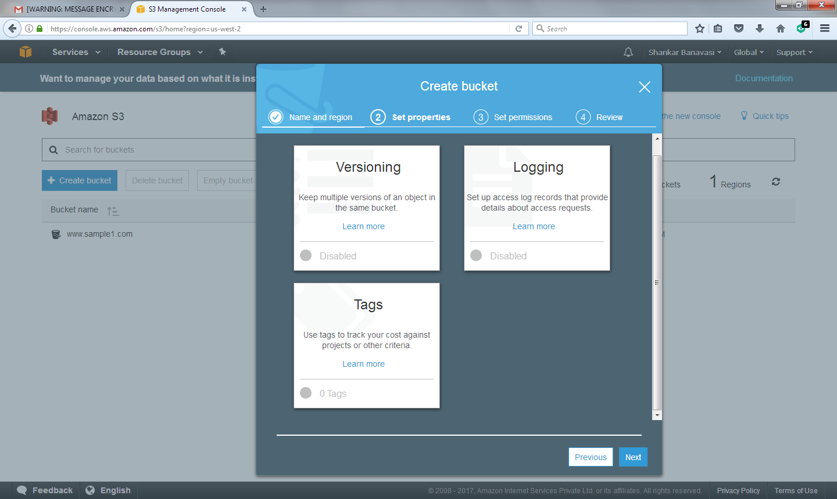
Storage – Amazon S3 (Set properties)
13/07/17
July 2017, Shankar Banavasi
33

Slide 34
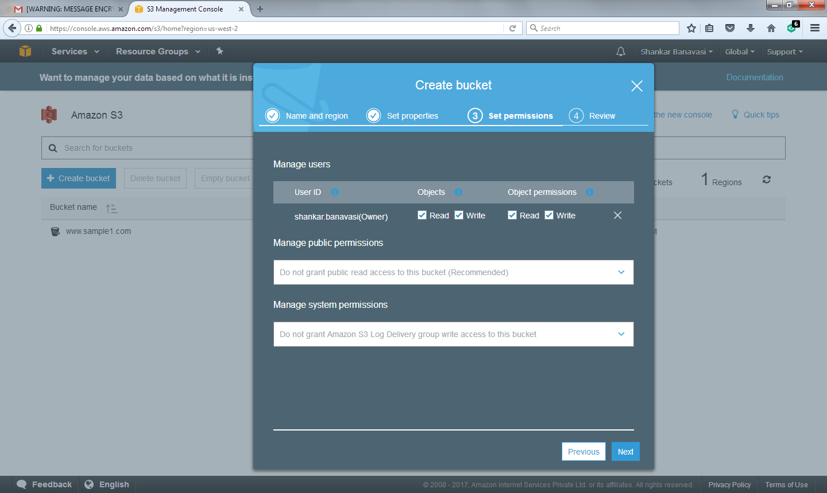
Storage – Amazon S3 (Set Permissions)
13/07/17
July 2017, Shankar Banavasi
34

Slide 35
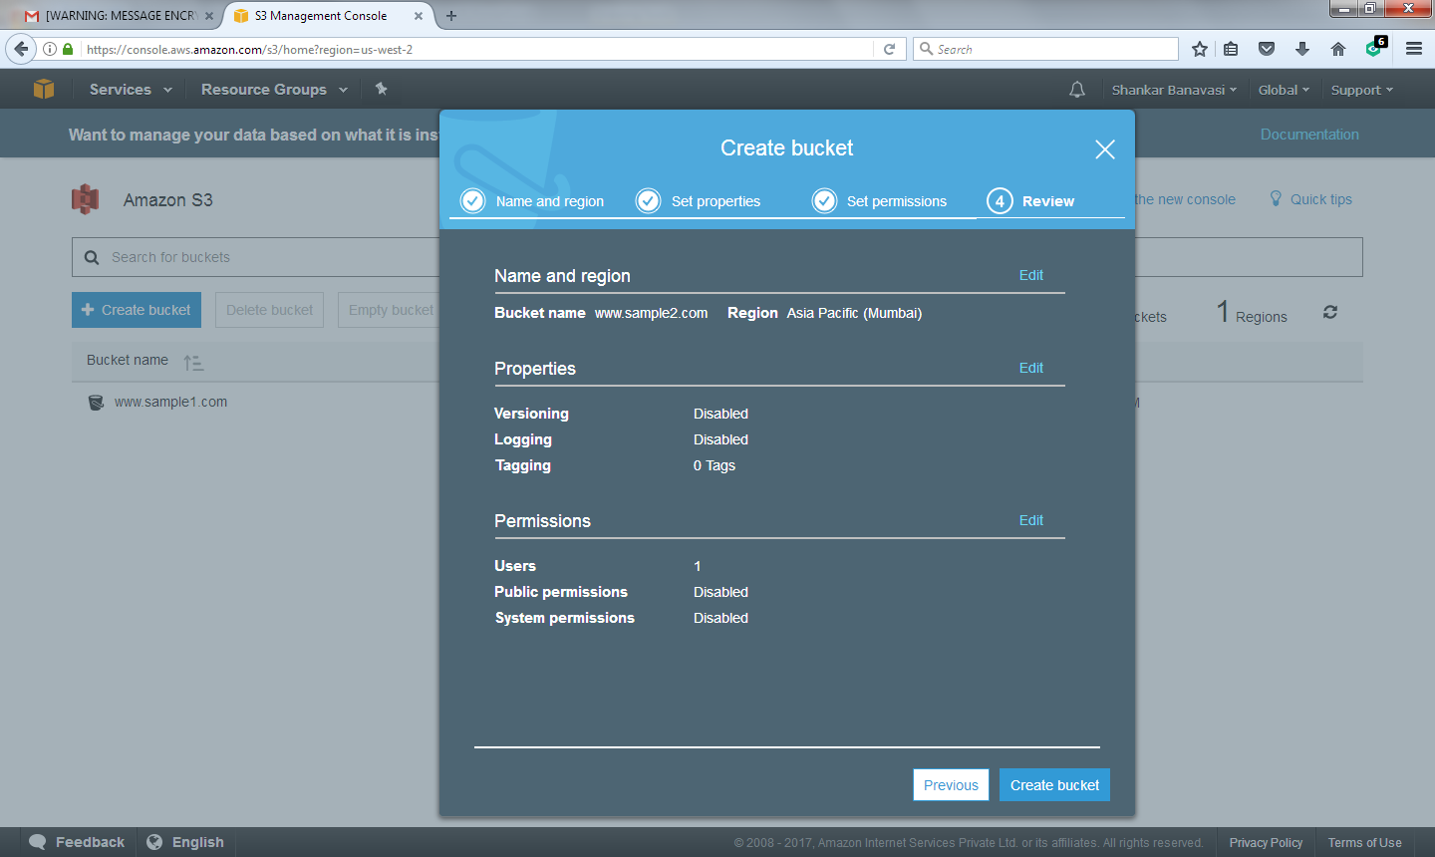
Storage – Amazon S3 (Review and Create Bucket)
13/07/17
July 2017, Shankar Banavasi
35

Slide 36
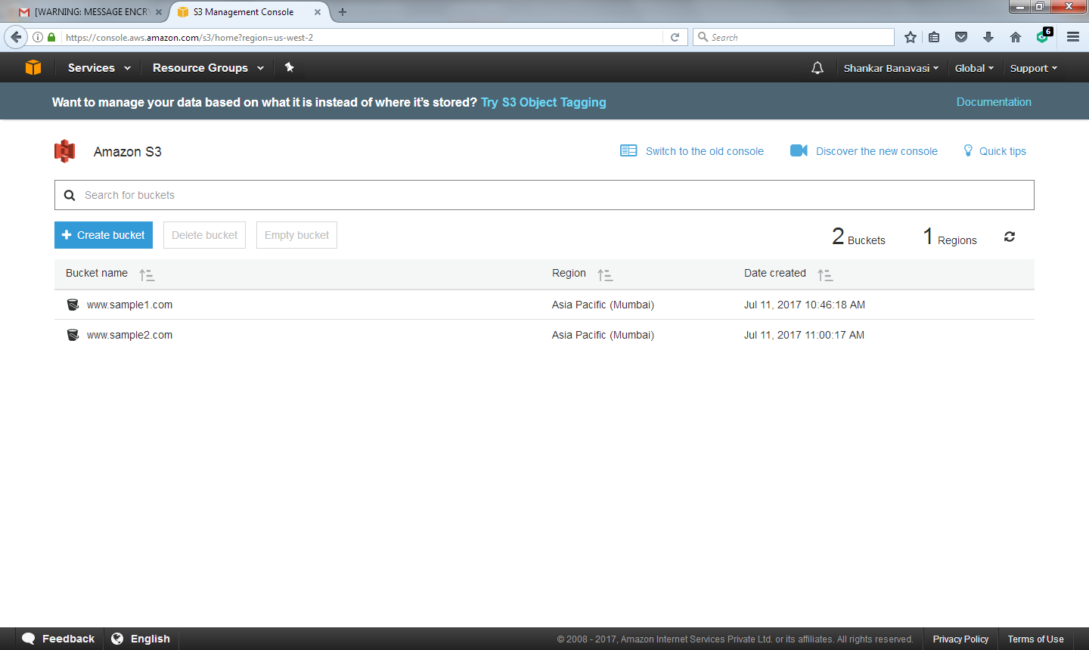
Storage – Amazon S3(S3 Management Console)
13/07/17
July 2017, Shankar Banavasi
36

Slide 37
Amazon S3 Features
Amazon S3 provides the most feature-rich object storage platform available in the cloud today.
Simple: Amazon S3 is simple to use with a web-based management console and mobile app. Amazon S3 also provides full REST APIs and SDKs for easy integration with third-party technologies.
13/07/17
July 2017, Shankar Banavasi
37

Slide 38
Amazon S3 Features
Durable: Amazon S3 provides durable infrastructure to store important data and is designed for durability of 99.999999999% of objects. Your data is redundantly stored across multiple facilities and multiple devices in each facility.
Scalable: With Amazon S3, you can store as much data as you want and access it when needed. You can stop guessing your future storage needs and scale up and down as required, dramatically increasing business agility

Slide 39
Amazon S3 Features(Continued)
Secure: Amazon S3 supports data transfer over SSL and automatic encryption of your data once it is uploaded. You can also configure bucket policies to manage object permissions and control access to your data using IAM.
Available: Amazon S3 Standard is designed for up to 99.99% availability of objects over a given year and is backed by the Amazon S3 Service Level Agreement ensuring that you can rely on it when needed. You can also choose an AWS Region to optimize for latency, minimize costs, or address regulatory requirements
13/07/17
July 2017, Shankar Banavasi
39

Slide 40
Amazon S3 Features (continued)
Low Cost: Amazon S3 allows you to store large amounts of data at a very low cost. Using lifecycle policies, you can set policies to automatically migrate your data to Standard - Infrequent Access and Amazon Glacier as it ages to further reduce costs.
13/07/17
July 2017, Shankar Banavasi
40

Slide 41
Amazon S3 Features (continued)
Simple Data Transfer: Amazon provides multiple options for cloud data migration, and makes it simple and cost-effective for you to move large volumes of data into or out of Amazon S3. You can choose from network-optimized, physical disk-based, or third-party connector methods for import to or export from Amazon S3

Slide 42
Amazon S3 Features(Continued)
Integrated: Amazon S3 is deeply integrated with other AWS services to make it easier to build solutions that use a range of AWS services. Integrations include Amazon CloudFront, Amazon CloudWatch, Amazon Kinesis, Amazon RDS, Amazon Glacier, Amazon EBS, Amazon DynamoDB, Amazon Redshift, Amazon Route 53, Amazon EMR, Amazon VPC, Amazon Key Management Service (KMS), and AWS Lambda.
July 2017, Shankar Banavasi
42

Slide 43
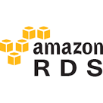
Amazon Relational Database Service (Amazon RDS)
Amazon Relational Database Service (Amazon RDS) makes it easy to set up, operate, and scale a relational database in the cloud.It provides cost-efficient and resizable capacity while managing time-consuming database administration tasks, freeing you up to focus on your applications and business. Amazon RDS provides you six familiar database engines to choose from, including Amazon Aurora, PostgreSQL,MySQL, MariaDB, Oracle and Microsoft SQL Server
13/07/17
July 2017, Shankar Banavasi
43

Slide 44
Amazon Relational Database Service
Easy to manage: Amazon S3 Storage Management features allow you to take a data-driven approach to storage optimization, data security, and management efficiency. These enterprise-class capabilities give you data about your data, so you can manage your storage based on that personalized metadata

Slide 45
Amazon -RDS
After having created an AWS account, navigate to the URL https://us-west-2.console.aws.amazon.com/rds/home?region=us-west-2#gettingStarted:
Click on the “Get Started Now” link on the above mentioned URL
You will then be led to the URL, https://us-west-2.console.aws.amazon.com/rds/home?region=us-west-2#launch-dbinstance:ct=gettingStarted: where you will come across a list of 6 databases namely, Amazon Aurora, MySQL, MariaDB, PostgreSQL, Oracle and Microsoft Server as can be observed from the following screenshots:
13/07/17
July 2017, Shankar Banavasi
45

Slide 46
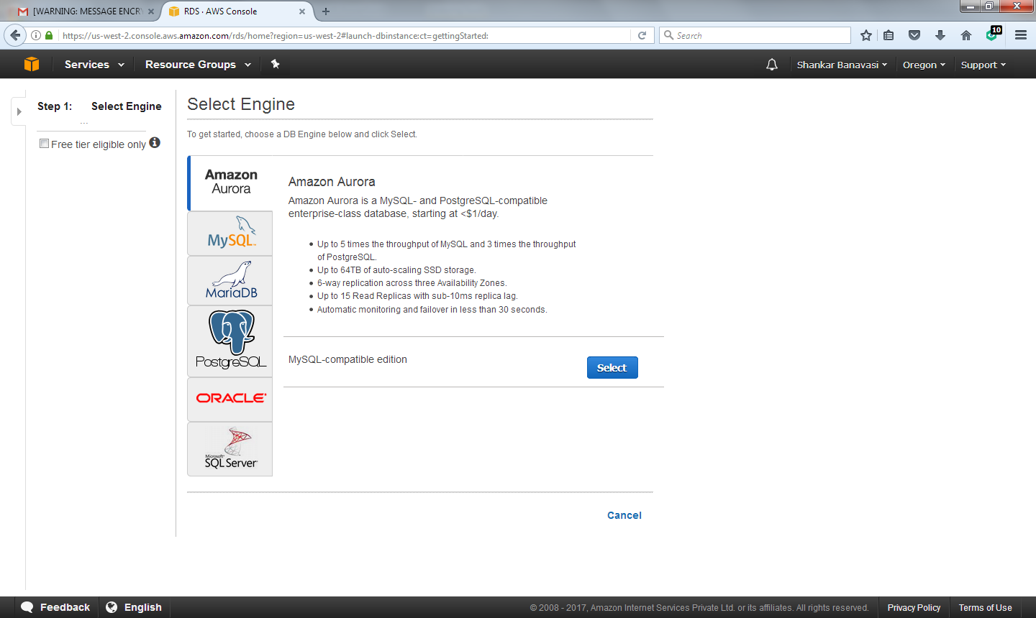
Amazon-RDS(Example)
13/07/17
July 2017, Shankar Banavasi
46

Slide 47
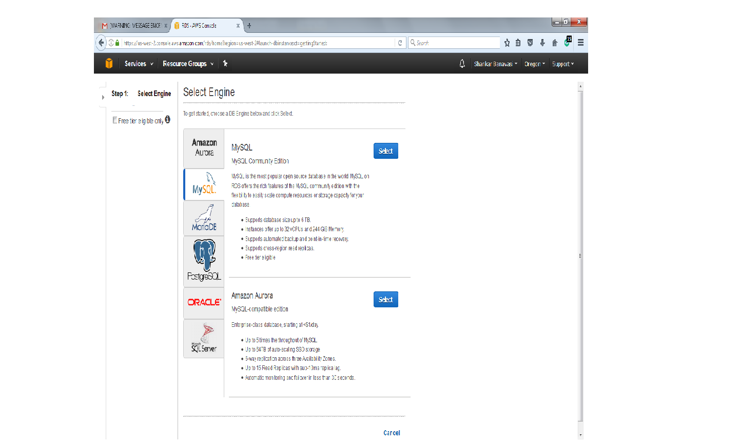
Amazon-RDS(Example, continued)
You can select the MySQL option and the choose Amazon Aurora –MySQL-compatible edition as shown:
13/07/17
July 2017, Shankar Banavasi
47

Slide 48
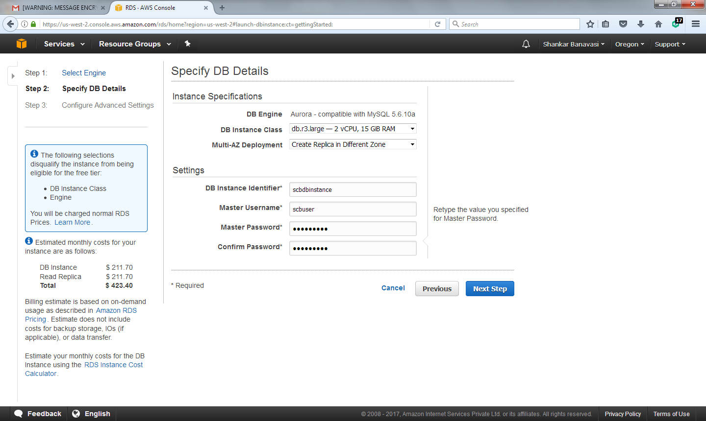
Amazon-RDS(Example,continued)
You can then specify Database and additional details as depicted with a DB instance specifier, master username as shown:
13/07/17
July 2017, Shankar Banavasi
48

Slide 49
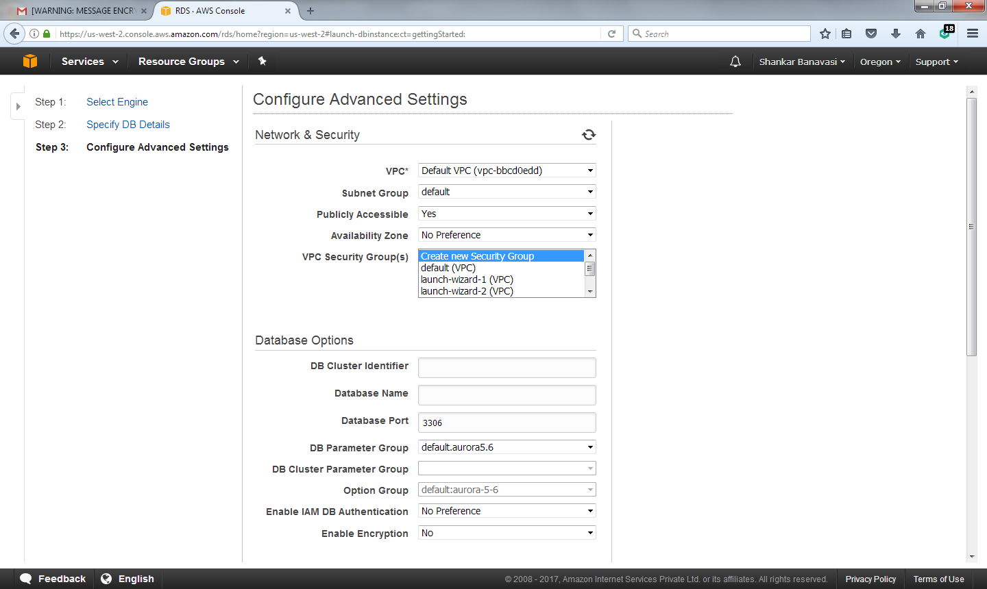
Amazon-RDS(Continued)
You can then go on to configure advanced settings and launch a DB Instance as shown :
13/07/17
July 2017, Shankar Banavasi
49

Slide 50
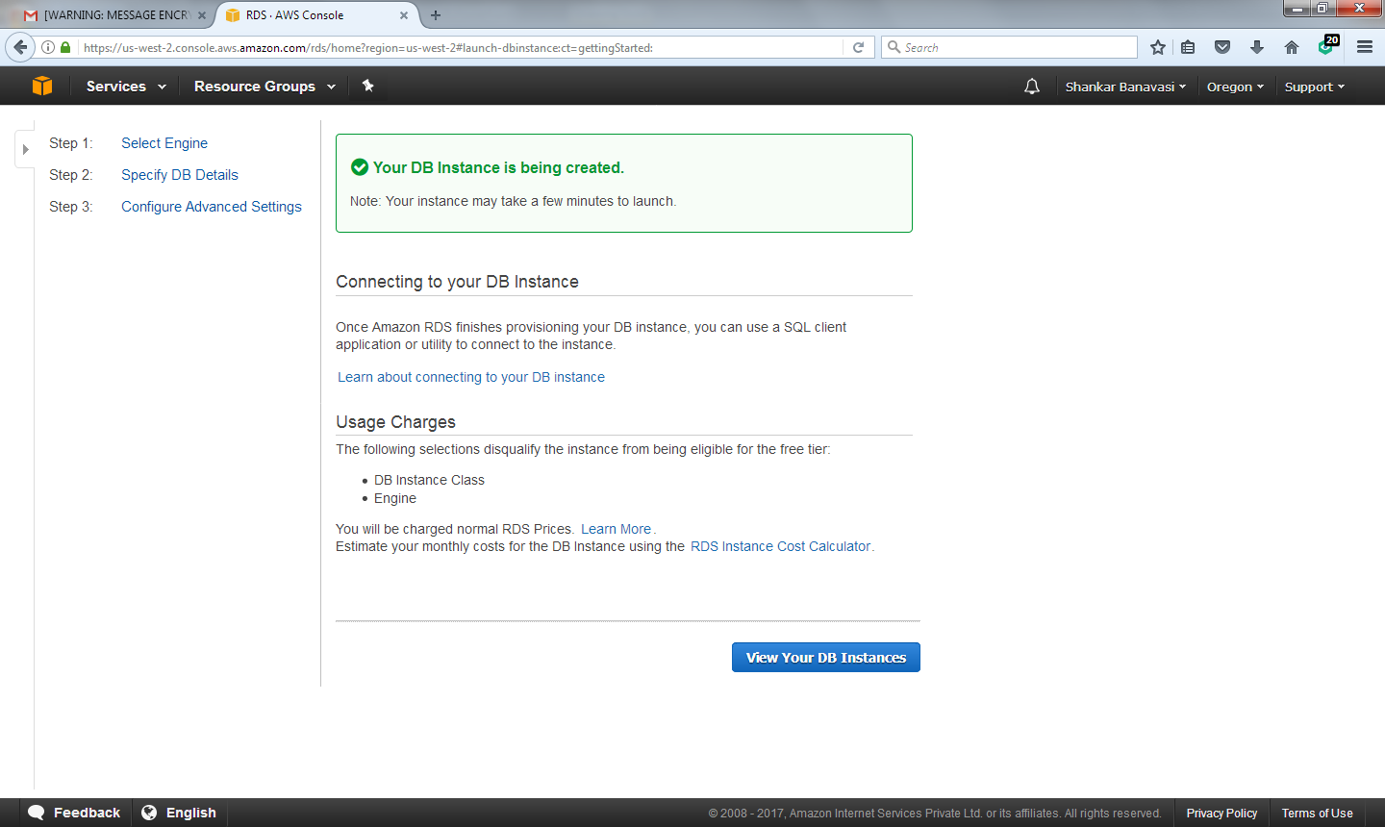
Amazon-RDS (DB Instance Created)
13/07/17
July 2017, Shankar Banavasi
50

Slide 51
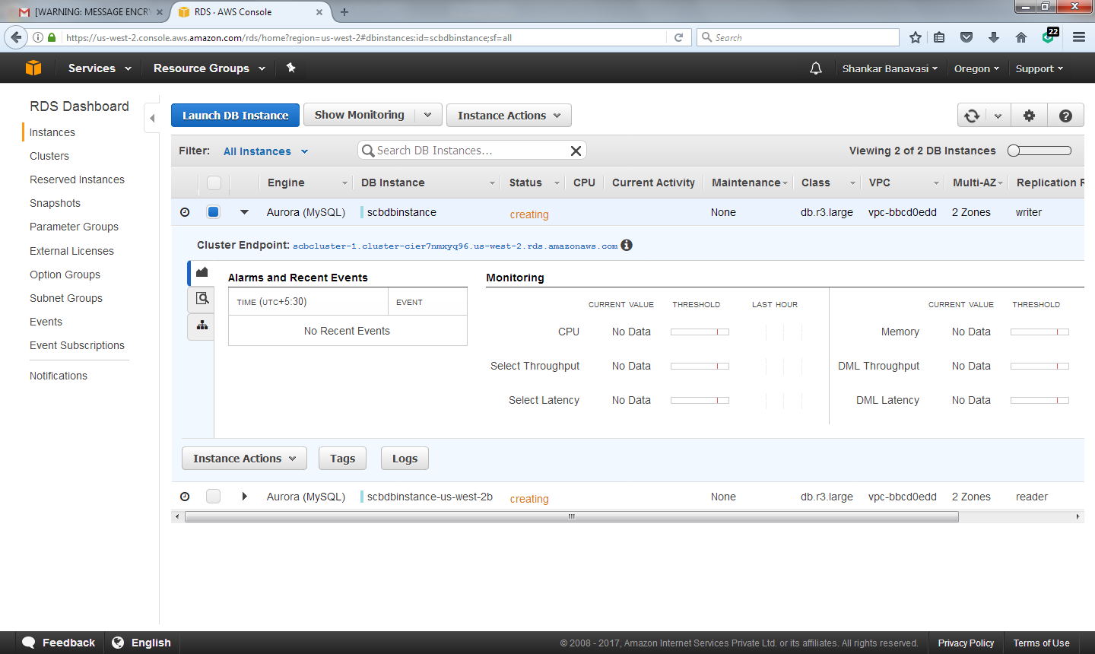
Amazon-RDS
13/07/17
July 2017, Shankar Banavasi
51

Slide 52
Benefits of Amazon RDS
Fast and Easy to Administer: Amazon RDS makes it easy to go from project conception to deployment. Use the AWS Management Console, the AWS RDS Command Line Interface, or simple API calls to access the capabilities of a production-ready relational database in minutes. No need for infrastructure provisioning, and no need for installing and maintaining database software.
13/07/17
July 2017, Shankar Banavasi
52

Slide 53
Benefits of Amazon RDS(continued)
Highly Scalable: You can scale your database's compute and storage resources with only a few mouse clicks or an API call, often with no downtime. Many Amazon RDS engine types allow you to launch one or more Read Replicas to offload read traffic from your primary database instance.

Slide 54
Benefits of Amazon RDS(continued)
Available and Durable: Amazon RDS runs on the same highly reliable infrastructure used by other Amazon Web Services. When you provision a Multi-AZ DB instance, Amazon RDS synchronously replicates the data to a standby instance in a different Availability Zone (AZ). Amazon RDS has many other features that enhance reliability for critical production databases, including automated backups, database snapshots, and automatic host replacement.

Slide 55
Benefits of Amazon RDS(Continued)
Secure: Amazon RDS makes it easy to control network access to your database. Amazon RDS also lets you run your database instances in Amazon VPC, which enables you to isolate your database instances and to connect to your existing IT infrastructure through an industry-standard encrypted IPSec VPN. Many Amazon RDS engine types offer encryption at rest and encryption in transit.
13/07/17
July 2017, Shankar Banavasi
55

Slide 56
Benefits of Amazon RDS(Continued)
Inexpensive: You pay very low rates and only for the resources you actually consume. In addition, you benefit from the option of On-Demand pricing with no up-front or long-term commitments, or even lower hourly rates using Reserved Instance pricing

Slide 57
References
https://aws.amazon.com/
https://aws.amazon.com/products/
https://www.youtube.com/user/AmazonWebServices
An_Overview_of_AWS_Cloud_Data_Migration_Services.pdf
aws-overview.pdf
https://www.youtube.com/watch?v=ae_DKNwK_ms
13/07/17
July 2017, Shankar Banavasi
57

Slide 58
YouTube Videos
https://www.youtube.com/watch?v=ae_DKNwK_ms
Introduction to Amazon EC2 - Elastic Cloud Server & Hosting with AWS:- https://www.youtube.com/watch?v=TsRBftzZsQo
Technical Introduction to Amazon Simple Storage Service (S3) - Cloud Storage on AWS :-
https://www.youtube.com/watch?v=Yyraql9A_Rc
Technical Introduction to Amazon RDS - Relational Database Service on AWS
https://www.youtube.com/watch?v=Kz1zmyHw9G0
13/07/17
July 2017, Shankar Banavasi
58

Slide 59
Thank you
Questions and Answers
Shankar Banavasi
13/07/17
July 2017, Shankar Banavasi
59

